Slide 1
Text Summarizer Using NLP (Natural Language Processing)
AAKASH SRIVASTAVA , KAMAL CHAUHAN , HIMANSHU DAHARWAL , NIKHIL MUKATI , PRANOTI SHRIKANT KAVIMANDAN
JUL 2022 | IRE Journals | Volume 6 Issue 1 | ISSN: 2456-8880
Presenter: Ram Krishna Pudasaini

Slide 2
Table of Content
Introduction
Methods of Summarizing Text
Frequency Based Approach - (TF-IDF)
Terminologies
Steps Involved
Test Cases
Conclusion

Slide 3
Introduction
Enormous amounts of information are available online on the World Wide Web.
Text summarization is a fast-growing field in natural language processing, and it has the potential to revolutionize the way we consume and process information.

Slide 4
Methods for Summarizing the Text Document
Extractive summarization involves selecting and extracting the most important information, typically sentences or phrases, from the source text to create a summary. The key idea is to identify and pull out the existing sentences that are deemed most relevant to the main ideas of the document.
Abstractive summarization simply doesn’t pick out the important sentences, rather, it analyses the input text and generates new phrases or sentences that capture the essence of the original text and convey the same meaning as the original text but more concisely and coherently.

Slide 5
Methods for Summarizing the Text Document
Both extractive and abstractive summarization have their advantages and challenges.
Extractive methods are generally considered more straightforward and can preserve the coherence of the original text, but they may lack creativity.
Abstractive methods, on the other hand, have the potential to generate more human-like summaries but can be challenging to train and may introduce factual inaccuracies.
The choice between the two depends on the specific requirements of the summarization task.

Slide 6
Frequency Based Approach
A frequency-based approach in machine learning typically involves analyzing the frequency of occurrence of various elements, such as words, features, or patterns, within a dataset. This approach is widely used in tasks like text analysis, feature engineering, and preprocessing.

Slide 7
Term Frequency-Inverse Document Frequency (TF-IDF)
A frequency-based approach in machine learning typically involves analyzing the frequency of occurrence of various elements, such as words, features, or patterns, within a dataset.
The TF-IDF approach is a popular and simple method for extractive summarization. It identifies important sentences based on the importance of individual words within the document and their uniqueness across the document collection. While effective, it has some limitations, such as not capturing semantic relationships between words or considering the order of words in sentences.

Slide 8
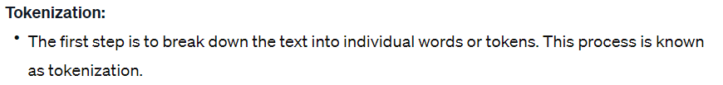
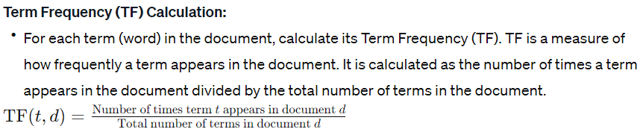
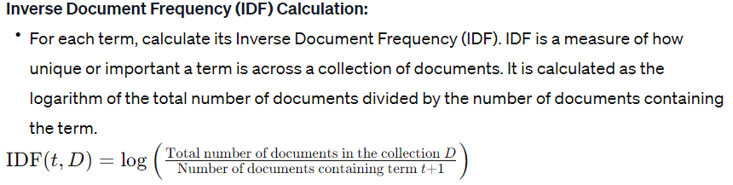

Slide 9
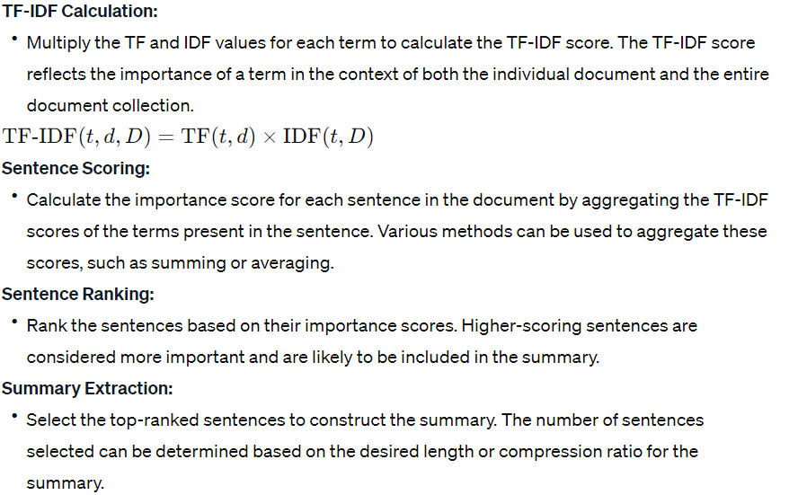

Slide 10
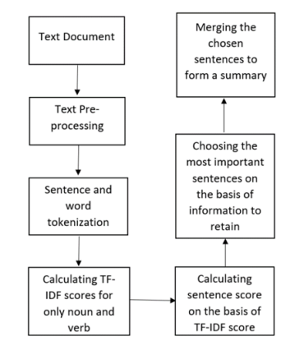
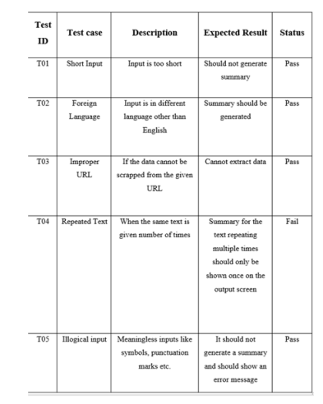
Steps Involved
Test Cases

Slide 11
Conclusion
Applications
TF-IDF is a weighting system that assigns a weight to each word in a document based on its term frequency (tf) and the reciprocal document frequency (tf) (idf). The words with higher scores of weight are deemed to be more significant.
Information retrieval
Keyword Extraction

Slide 12
Thank You

